Slide 1
Lectures 23-25
Implications of the Holistic Understanding
Module 5 – Implications of the Holistic Understanding – a Look at Professional Ethics

Slide 2
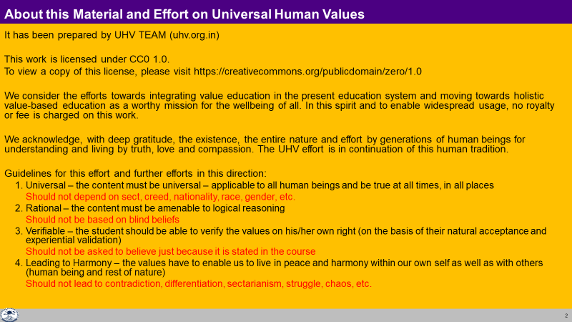

Slide 3
Module 5 – Implications of the Holistic Understanding – a Look at Professional Ethics
(6 lectures and 3 tutorials/ practice sessions)
Lecture 23: Natural Acceptance of Human Values
Lecture 24: Definitiveness of (Ethical) Human Conduct
Tutorial 12: Practice Session PS12 Exploring Ethical Human Conduct
Lecture 25: A Basis for Humanistic Education, Humanistic Constitution and Universal Human Order
Lecture 26: Competence in Professional Ethics
Tutorial 13: Practice Session PS13 Exploring Humanistic Models in Education
Lecture 27: Holistic Technologies, Production Systems and Management Models-Typical Case Studies
Lecture 28: Strategies for Transition towards Value-based Life and Profession
Tutorial 14: Practice Session PS14 Exploring Steps of Transition towards Universal Human Order
It may be pertinent to mention that this course also presents a rather ‘unconventional’, but more fundamental approach to professional ethics where the major focus is on the development of the ethical competence of the individual rather than relying only on codes of conduct, oaths, whistle-blowing etc.

Slide 4
Placement of Module 5
Understanding Harmony
Modules
Feeling of relationship 1-4
mutual fulfilment, values
Thought Principles and
Guidelines for
Ethical Human Conduct
Module 5
Behaviour Ethical behaviour
Work and Ethical work (examples and
Participation Ethical participation case studies…)
Outcome Continuous happiness at individual level and
expected Fulfilment of human goal at societal level

Slide 5
For more details
UHV-II: A Foundation Course in Human Values and Professional Ethics
Universal Human Values-II Understanding Harmony and Ethical Human Conduct
A one-semester 3-credit mandatory course in the AICTE Model Curriculum 2021
Presentations, Handout of Class Notes:
https://fdp-si.aicte-india.org/download.php#1
Recordings on YouTube: Professional Ethics lectures of UHV-II Lectures 23-28
https://www.youtube.com/watch?v=BikdYub6RY0&list=PLWDeKF97v9SPFYVPis99l9eD-wZf0RypK

Slide 6
Lecture 23
Natural Acceptance of Human Values

Slide 7
Basis for Universal Human Values
Recap
In previous lectures, we concluded by identifying co-existence in the entire existence.
In the following lectures, we will try to understand how right understanding provides the basis for universal human values enabling their natural assimilation.

Slide 8

Natural Acceptance of Human Values
Based on our understanding of harmony, we participate in the larger order.
Our participation at different levels is our value.
The identification of values is based on realisation and understanding.
The participation of the human being is in the form of behaviour, work and participation in the larger order
We studied about the values of behaviour as the values in relationship: trust, respect, affection, care, guidance, reverence, gratitude, glory and love.
It results into mutual happiness
Likewise, work with material things, ensuring their right utilisation, enrichment and protection is our value.
It results into
  prosperity for human being and
preservation of the rest of nature (enrichment, protection and right utilisation)

Slide 9
Consolidated List of Human Values
In the Self – Continuous happiness- Happiness, Peace, Satisfaction, Bliss
In Human Being- with Body- Feeling of self-regulation in self, health in body
In Human-Human Relationship – Justice
(established values- trust,… love + expressed values- … compassion)
4. In Human-Rest of Nature Relationship – Prosperity in human being, preservation (enrichment, protection and right utilisation) of rest of Nature
5. In Universal Human Order – participation in different systems -Perseverence, Bravity, Generosity, Kindness, Beneficience, Compassion –
The value of a human being is something definite
In that sense, human values are definite
The participation of a human being living with human consciousness is definite – in the Self, in human-human relationship, in human-rest of nature relationship and in the human society (universal human order)
NOTE: That definite participation can be described in multiple ways
This is one description of that definite participation (human values)

Slide 10
Universal Values Naturally Emerging from the Right Understanding
From earlier discussions, we can easily infer that there is an innate harmony and orderliness in the existence.
The human beings only need to understand it (and not to create it).
The universal human values are manifestations of the truth of existence, i.e. co-existence, in various dimensions of human participation in the existential order.
These values are naturally acceptable to all human beings and conducive to human happiness (an wellbeing of all).
Only our ignorance leads to all the difficulties and confusions in appreciating and inculcating these universal values.

Slide 11
Development of Human Consciousness
As explained earlier, the journey towards right understanding in fact brings a transformation in the human being from ‘animal consciousness’ to ‘human consciousness’.
In ‘animal consciousness’, we give first priority to physical facility.
But as we transform to the human consciousness, we are able to base our thoughts and activities on right understanding, give relationship a higher priority than physical facility, identify our physical needs and ensure it through cyclic and mutually enriching production processes, thereby enriching rest of the nature as well.

Slide 12
Implications of Value-based Living
At the level of individual:
  Transition towards happiness and prosperity, slowly getting rid of the contradictions and conflicts within through self-exploration and thus getting rid of the tension, frustration, depression, one-upmanship, psycho-somatic disorders etc. facilitating definite human conduct.
  The feeling of self-regulation will reduce the occurrence of diseases and in turn the feeling of insecurity. This will help the individual lead a more fulfilling life.
At the level of family:
  Value-based living facilitating peace and harmony in the family, with more occurrences of just and fulfilling behaviour raising the feeling of togetherness in the families and reducing the family feuds.
  People will feel prosperous and the feeling to nurture others will grow in the families.
  Such harmonious living will also help reduce the consumerist behaviour in family celebrations like marriages, parties and other social functions.

Slide 13
Implications of Value-based Living…
At the level of society:
  Mutual trust and fearlessness developing in the society, reduction of discrimination on the basis of body (in terms of gender, age or race), physical facility (in terms of wealth or posts) and beliefs (in terms of isms, sects, etc), solution emerging to problems like terrorism, communalism and international conflicts etc.
  The feeling of undividedness will grow in the society.
  Fulfilment of human goal will start getting to the fore in our plans and projects at all levels and gradually a human order based on trustful relationships will slowly emerge.
At the level of nature:
  Human order fulfilling all the other three orders of nature, problems of pollution and resource depletion being handled smoothly when people are able to judge appropriately their needs for physical facility themselves and the mode of fulfilment is eco-friendly.
  Better methods of farming and production will help cut down problems of greenhouse gases, ozone depletion, ecological imbalance, etc.
  The various species of animals and birds can be saved from extinction and forests can be replenished.

Slide 14
Key Takeaways
Human Values are naturally acceptable
Living with Human Values leads to mutual happiness and mutual prosperity
Value-based living is a natural outcome of the right understanding.
Its implications can be seen at all levels of living of human being.

Slide 15
Why ethics when right understanding is already ensured?
Details helpful for review of conduct, for sharing…
For Children, who are in the stage of following, discipline
Ethics
How we express, how we fulfil..
Not only about restrictions

Slide 16
Lecture 24
Definitiveness of (Ethical) Human Conduct

Slide 17
Definitiveness of Ethical Human Conduct
Harmony at Different Levels | Expression & Achievement
Harmony at the level of Self | Happiness
Harmony of the Self with the Body | Feeling of self-regulation at the level of Self and Health at the level of body
Harmony in the family, in human-human relationship | Mutual happiness, trust, fearlessness… justice
Harmony with rest of nature | Mutual prosperity – prosperity in human being and preservation of rest of nature
Harmony with the whole of nature/ existence | Co-existence (mutual fulfilment) with entire Nature

Slide 18
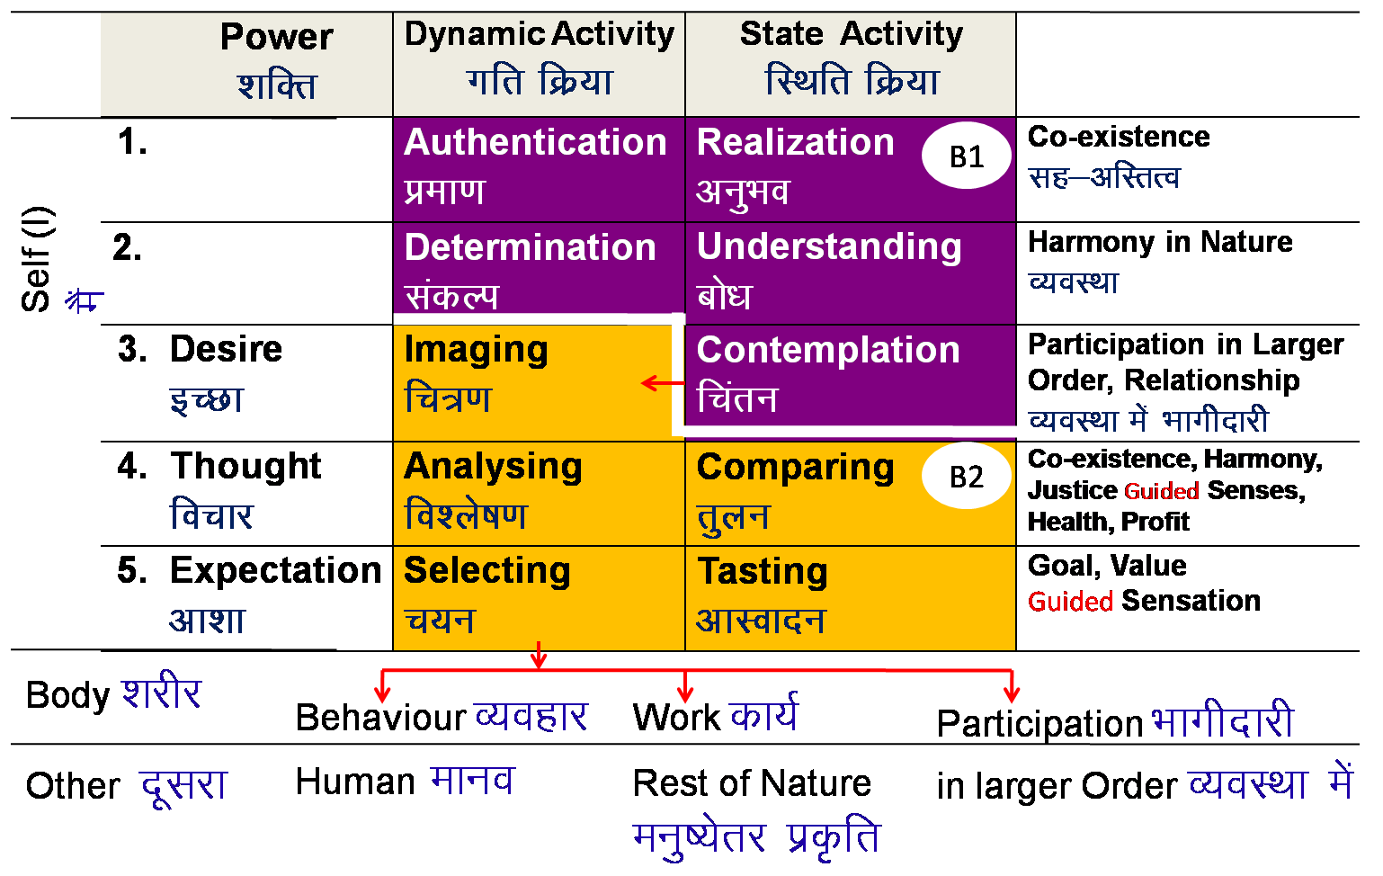
Definitiveness of Ethical Human Conduct- View 1
vuqHko& Lo;a esa
Realization- Within
Mutual Happiness
mHk; lq[k
Mutual Prosperity
mHk; le`f)
Fulfillment of Human Goal
Ekkuo y{; dh iwfrZ
Human Tradition
ekuoh; ijaijk
Undivided Human Society
v[k.M ekuoh; lekt
vfHkO;fDr& ckgj
Expression- Outside
Universal Human Order
lkoZHkkSe ekuoh; O;oLFkk

Slide 19
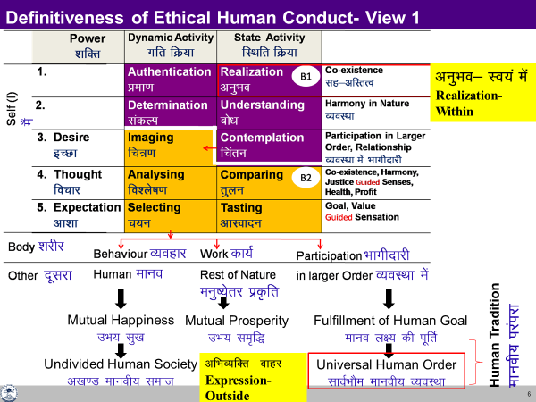
Definitiveness of Ethical Human Conduct- View 1
As described in the last diagram,
It all starts with
realisation of co-existence and completes with
participation in the universal human order with
right feelings, right thought and
mutually fulfilling behaviour & work in between *
* We have already discussed this in quite details in previous lectures, hence we will not take up the details here.

Slide 20
Definitiveness of Ethical Human Conduct- View 2
The ethical human conduct can be further grasped in terms of
Values,
Policy and
Character

Slide 21
Values, Policy and Character – Ethical Human Conduct
Human Values – Understanding "What to do as a human being" and
"What not to do as a human being"
Policy – Detail, thought of "how to do" Human Constitution
Includes plan, program, implementation, results, evaluation
    Policy for enrichment of Self (I), Body, Physical Facility (Human Economics)
    Policy for protection of Self (I), Body, Physical Facility (Human Politics)
    Policy for right utilisation of Self (I), Body, Physical Facility (Human Sociology)
Character –
    Compassionate behaviour, work and participation in larger order
    Rightfully acquired wealth
    Chastity in conjugal relationship

Slide 22
Values
Understanding "What to do as a human being" and "What not to do as a human being" *1
Understanding of role of Human Being in Existence
Once we have the right understanding (of relationship, harmony and co-existence), we are able to see our natural participation or values at all levels of being – from individual, to family, society, nature/existence.
This participation or the human values are definite and form the basis of our ethical human conduct.
*1 To be able to distinguish between “source of continuous happiness and temporary excitement”…

Slide 23
Values
Value of a unit is its participation in the larger order
(larger order = larger, harmonious system)
e.g. Value of pen is that it helps to write
(participation in education)
Value of water is that it quenches thirst
(participation in health)
Similarly,
Your value wrt to yourself is your participation in the harmony within you (in the Self).
Value of your body is participation in your external activities as a harmonious human being.
Your value in the family is your participation in the harmony in the family.
Your value in the society is your participation in the harmony in the society.
Your value in the nature is your participation in the harmony in the nature.
Your value in the existence is your participation in the co-existence.
In this course, we tried to explore the universal values of a human being.

Slide 24
Sum Up
Level. Name | Relationship / Potential- Values | Details
4b. Existence | Co-existence | Co-existence Potential for human being to realise
4a. Nature | Mutual Fulfillment | Harmony, Relationship Potential for human being to be in harmony
3. Society | Right Understanding, Prosperity, Fearlessness (Trust), Co-existence | Human-Nature relationship Potential, through participation of individuals and families in various societal systems
2. Family | Feeling of co-existence Trust, Respect … Love | Human-Human relationship Potential for right feeling in the Self – mutual happiness
1b. Individual Human Being | Co-existence of Self and Body | Self-Body relationship Potential for feeling of self-regulation
1a. Self (I) | Continuous happiness = happiness, peace, satisfaction, bliss | Will to live with continuous happiness Potential for right understanding, right feeling and right thought → mutually fulfilling behavior and work
Universal Values

Slide 25
Policy
Thought of how to express (live with) Human Values
Detail, thought of "how to do" Human Constitution
Includes plan, program, implementation, results, evaluation
Policy for enrichment of Self (I), Body, Physical Facility (Human Economics)
Policy for protection of Self (I), Body, Physical Facility (Human Politics)
Policy for right utilisation of Self (I), Body, Physical Facility (Human Sociology)
Priority
Right utilization
Protection
Enrichment

Slide 26
Policy – Detail, thought of "how to do"–Human Constitution
Includes plan, program, implementation, results, evaluation
    Policy for enrichment of Self (I), Body, Physical Facility (Human Economics)
    Policy for protection of Self (I), Body, Physical Facility (Human Politics)
    Policy for right utilisation of Self (I), Body, Physical Facility (Human Sociology)
Policy for right utilisation (priority1)
Of Self (I) Policy for investing the Self (I) for understanding and living in harmony at all levels
Of Body Policy to ensure that the body is used for ensuring right understanding and right feeling in the self as well as its authentication in living, including behavior, work and participation in larger order
Of PF Policy to ensure the use of PF for nurturing, protection and right utilisation of the body. Policy for right utilisation of physical facility for relationship and societal order

Slide 27
Policy for Protection (priority 2)
For Self (I) Policy for ensuring conducive environment for the Self (I) for understanding and living in harmony at all levels and protecing from unfavourable environment
For Body Policy for ensuring shelter, clothes…
For PF Policy for preservation, proper storage…
Policy for Enrichment (priority 3)
For Self (I) Policy for education-sanskar, adult education, other efforts (such as development of sanskar through societal functions, ceremonies…), for understanding and living in harmony at all levels in the Self (I)
For Body Policy for intake-lifestyle to ensure health of body
For PF Policy for production with right process & right skills

Slide 28
Character
Expression of Human Values in Behavior, Work and Participation in the Larger Order
This can be understood in terms of the following:
  Rightful acquisition and utilization of wealth – by way of labour, using cyclic and mutually enriching production processes.
  Compassionate behaviour, work & participation in larger order on the basis of human values
    Behaviour– ensuring justice, mutual happiness (while filling the gaps created in ignorance)
    Work – ensuring preservation, mutual prosperity (while filling the gaps created in ignorance)
    Participation in larger order- leading to fulfilment of the comprehensive human goal
    (while filling the gaps created in ignorance)
  Chastity in conjugal relationship i.e. chastity in husband-wife relationship.

Slide 29
Rightfully Acquired Wealth
Production- through labour on rest of nature (using cyclic and mutually enriching production processes) or physical facility obtained in exchange of service
Gift – wealth shared willingly / happily (with the feeling of relationship) from one’s rightfully acquired wealth on various occasions like festivals (ex. gift in relationship)
Award – physical facility / wealth given with joy in a function to recognise one’s contribution to society (participation in the societal order) and for motivating others

Slide 30
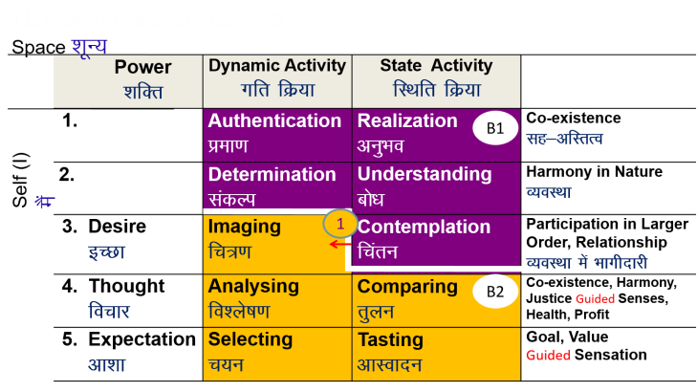
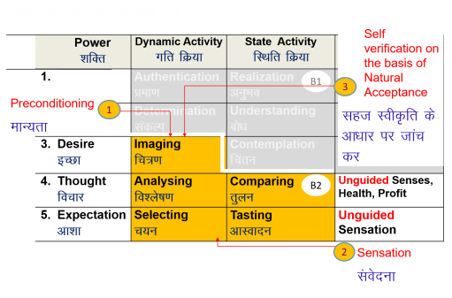
Understanding Harmony
Feeling of relationship
mutual fulfilment
Thought how to be mutually
fulfilling
Behaviour Ethical behaviour
Work and work
Participation participation
Promotion Self discipline, Complementarity
(Human Constitution)
Outcome Mutual happiness
Prosperity in human being
Preservation of rest of nature
Preconditioning Conflict…
Feeling of opposition,
competition…
Thought Mixed,
how to maximise my gains...
Behaviour Indefinite behaviour
Work and work
Participation participation
Promotion Discipline
Fear of punishment
Incentive of reward…
codes of conduct,
oaths, whistle-blowing…
Outcome Mixed
VALUES
POLICY
CHARACTER

Slide 31
Ethical Human Conduct
Further
‘Ethical conduct’ implies that it is naturally acceptable to me and does not give rise to conflict within
‘Ethical conduct’ implies that it is in consonance with the right understanding of the reality – the underlying harmony at all levels.
‘Ethical conduct’ implies that it leads to mutual fulfilment with other people and mutual enrichment with rest of nature
Thus, the ‘ethical conduct’ is self-satisfying, people-friendly and eco-friendly for all time, place and individual.

Slide 32
Key Takeaways
Ethical human conduct emerging out of right understanding leads to harmony at all levels of being – from oneself to family, society and nature/ existence.
It is definite for all time, place and individual.

Slide 33
Tendency of Human Living with Human Consciousness
= Natural Characteristic of Human Being with Human Consciousness
Perseverance
Brevity
Generosity
Kindness Providing means to one who has the ability but not the means.
Beneficience Helping the other to develop the competence to utilise the means they already have.
Compassion Helping the other unconditionally, to develop the competence as well as the means, to fulfill his needs when he does not have either the ability nor the means.

Slide 34
Lecture 25
Professional Ethics in the light of Right Understanding

Slide 35
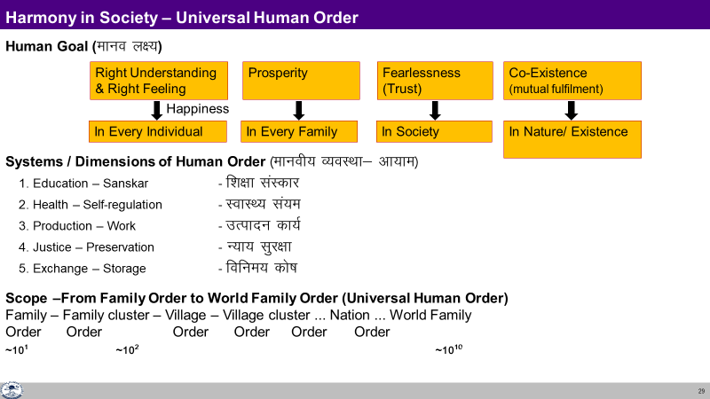
Profession – In Context of the Comprehensive Human Goal
A profession is a mode of participation by human beings in the larger order in pursuance of comprehensive human goal-individual & collective.
The excellence or the success of any professional activity is to be judged from this comprehensive point of view only and not in terms of merely wealth generation.
The profession is not only a means of earning one’s livelihood, but also a means of one’s evolution by appropriate participation in the larger order.
It is an important activity to authenticate one’s understanding, whereby we interact with other human beings and with rest of nature in a mutually fulfilling manner.

Slide 36
Professional Ethics
Professional ethics can be seen as the code of ethical conduct of the profession (as defined above).
Ethical conduct of profession implies the right utilization of one’s professional skills for participation in the larger order towards the fulfillment of comprehensive human goal.

Slide 37
Salient Features Characterizing Professional Ethics
Clarity about the comprehensive human goal
Confidence in oneself as well as confidence in the harmony, coexistence and self-regulation prevailing in entire existence
Competence of mutually fulfilling behaviour
Competence of mutually enriching interaction with nature
Holistic vision about technologies, production systems and management techniques.
Understanding of one’s societal responsibility

Slide 38
Issues in Professional Ethics – The Current Scenario
The issues in professional ethics are becoming very complex in the current scenario.
The unethical practices are rapidly increasing and their impact is also becoming far-reaching.
As a result of this ‘epidemic’ of unethical practices, we are frequently coming across serious scams, major economic offences, kickbacks in large scale purchases etc.

Slide 39
Some Salient Categories of Unethical Practices Today
Corruption in multiple forms and at various levels
Tax evasion, misappropriation and misuse of public funds
Misuse of political power and bureaucratic authority
Misleading propaganda, unethical advertisements and sales promotion
Cut-throat competition
Exploiting the weakness of consumers through various enticements, bewildering advertisements
Adulteration and spurious production
Endangering the health and safety of public at large
Hoarding and over-charging etc.
The list could be much longer…

Slide 40
Prevailing Approaches towards Promotion of Professional Ethics
Promoting awareness about professional ethics by introducing new courses, refresher programs and case studies
Administering oaths and prescribing codes of ethical conduct for specific professional disciplines
Setting up mechanisms for intensive audit inspection and monitoring the activities
Framing more stringent laws and devising harder punishments for offences Promoting transparency in working systems through mechanisms like RTI (Right to Information Act), etc.
Carrying out ‘sting operations’ and widely publicising serious lapses in ethical conduct of profession through media
Encouraging whistle blowing by individuals or groups
Setting up Lokpals, vigilance commissions, ethics committees, tribunals, consumer protection forums, etc.
Filing public interest litigations (PIL), etc.

Slide 41
Inadequacy of Prevailing Approaches
Looking at the various methods and mechanisms which are being presently employed to check these trends and their effectiveness, one can see that most of the methods being adopted are either of symptomatic nature or punitive measures or crisis management techniques rather than real solutions to the whole problem.
The focus in these methods is primarily towards curbing the ill effects rather than rectifying the root cause, namely the faulty world-view which continues to remain dominant (managing the disease rather than ensuring health).

Slide 42
Inherent Contradictions and Dilemmas
We can understand more clearly through examples how the contradictions and dilemmas are inherently generated by the prevailing worldview in which wealth maximization is perceived to be the prime objective.
Thus, the other person’s happiness (assumed to be related to wealth accumulation) seems to be in conflict with my happiness.
In that case, the other people have to be exploited for one to gain affluence and there is no possibility of mutual fulfillment in a sustainable way.
In the same way, exploitation of nature also becomes inevitable as it helps a person to accumulate wealth easily and there is no limit to this.
Take the example of business circles, whenever there is a scarcity of commodity due to say – monsoon failure or other natural disturbances or wars etc., the people in general are in distress and need support. However, in such a situation, the businessmen endowed with prevailing (inhuman) world view will feel elated and look at it as an opportunity to make maximum profit.

Slide 43
Different Approaches to Ethics and Professional Ethics
 | Prevalent (Prescriptive) | Proposed (Humane)
Basis | Assumptions (thought) | Right Understanding of co-existence, harmony and relationship
Feeling | Opposition | Relationship
Values | Assumed values – based on assumptions and opposition | Naturally acceptable values, Wellbeing of all
Ethics: How to interact with the world outside | Mostly prescriptive, in the form of do’s and don’ts | Details based on right Understanding (as described)- verifiable by everyone thru NA Basic agreements for order in society
Way of ensuring in society | Training, Discipline Incentives and punishment | Human Education, Self-discipline Self-motivation

Slide 44
The Way Ahead
To resolve the situation, sincere effort towards building up the ethical competence of human beings in general and professionals in particular through human education [starting with value education and value based education leading to value-based living]
It can be an effective way to safeguard professional ethics.

Slide 45
Key Takeaways
Clarity of comprehensive human goal and our participation in different dimensions of society will ensure Ethics in profession.
This also clarifies the lacunae in the present approaches.

Slide 46
Practice Sessions
For Module 5 (Lectures 23-25)

Slide 47
Practice Sessions
Human Constitution (Nature of society of people living together in a relationship of mutual fulfillment)
    Family
    Apartment building
    Colony
    Village
    College
    Department
    Business Company Culture, Code of Conduct, Ethics..
    Industry
Guidelines for technology
Guidelines for management systems

Slide 48
Practice Session after Lecture 24
Tutorial 12: Practice Session PS12 Exploring Ethical Human Conduct
Watch the video “Hiware Bazaar”. It is a documentary about a progressive village in Maharashtra, India about how good governance, along with the people of the village have made significant change in their society (Source: https://www.youtube. com/watch?v=cb0Qvh9BJ0s). Discuss:
    The goal of this village and the systems that they have to fulfil these goals
    The outcomes – achievements and areas of improvement You can additionally pick current social problems in the campus or neighboring community and discuss how they can be solved with the involvement of the students and teachers.
2. Recollect any situation in your life when you had to face a strong ethical dilemma. Explain how, with the help of proper self-exploration and understanding, the dilemma could be resolved.

Slide 49
Expected Outcome
The students are able to clearly visualise the corelation between lack of Human Values and the prevailing problems. They are also able to visualise tangible steps and a roadmap for moving in the cherished direction – for a humane society.

Slide 50
FAQs for Lectures 23-25
Ethics

Slide 51
Questions
What can be a sustainable solution to the problem of corruption?
The planet has already entered the state where so much of destruction has taken place. How to recover the damage done already?
...

Slide 52


Slide 53
Self Reflection

